Slide 1
no waiting cars
Cycles for main_s
light_main = GREEN
light_side = RED
out_valid = 0
Cycles for main_lt
Cycles for side_s
!rst_n
Cycles for side_lt
cnt_in
tl_start
!tl_start
counter = cnt_in
counter
-
out_valid = 1
in_valid
no cnt_in
calculate and store cycles
for all tl’s
counter = counter – 1
cnt_done = (counter == 1)

Slide 2
init
done
Cycles for main_s
cnt_done &
no cars waiting
Cycles for main_lt
tl started
cnt_in = cycles for main_s
tl stopped
main_lt_waiting
GREEN
LEFT
cnt_done
cnt_done &
main_lt cars waiting
cnt_done &
cars waiting
no main_lt cars &
side cars waiting
cnt_in = cycles for main_lt
YELLOW
RED
cnt_done &
no cars waiting
-
main_lt waiting:
cnt_in = 2 side_s or side_lt waiting:
cnt_in = 1
Otherwise:
cnt_in = 1
tl stopped
priority
done

Slide 3
init
cnt_done &
no side_s cars &
side_lt cars
Cycles for side_s
Cycles for side_lt
no cars in main road
cnt_in = 2 from upper FSM
cnt_in = cycles for side_s
side_s_waiting
side_lt_waiting
RED
LEFT
cnt_done &
side_s cars
-
cnt_in = 2
cnt_in = cycles for side_s
cnt_done
GREEN
YELLOW
cnt_done

Slide 4
FSM for
Enabling TL
FSM for
main light
FSM for
counter
FSM for
side light

Slide 5
Hierarchical view
FSM for
counter
Input
FSM for
Enabling TL
FSM for
main light
FSM for
side light
Output
out_valid
light_main
light_side

Slide 6
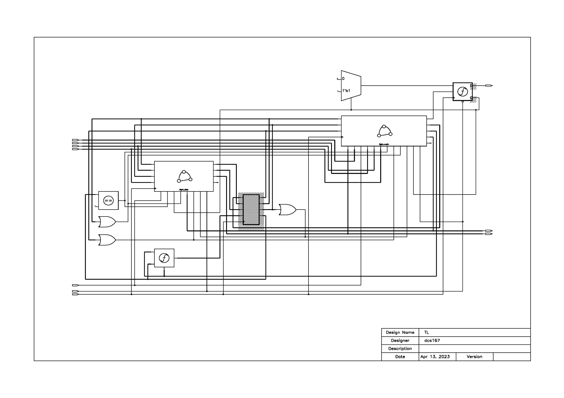
Output
Logic
FSM for
main light
FSM for
side light
Storage
Elements
counter

